Slide 1


Workshop SWP391 Back-End technologies in use

Slide 2
Content
Back-End development
Tools & technologies for Back-End development
Popular Back-End programming languages
Demo - Building simple RESTful API with Spring Boot
Demo - Building simple RESTful API with NodeJS

Slide 3
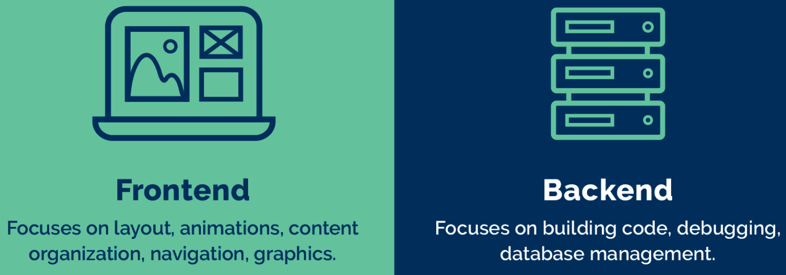
Front-End vs. Back-End
Refers to the client-side of development.
It encompasses everything users interact with directly in their web browsers or mobile applications.
User interface (UI) and user experience (UX) design, ensuring that users have a visually appealing and functional experience.
Refers to the server-side of development.
It involves the server, database, and application logic that work behind the scenes to deliver data and functionality to the front-end.
Application logic, data processing, server management, and database interactions.

Slide 4
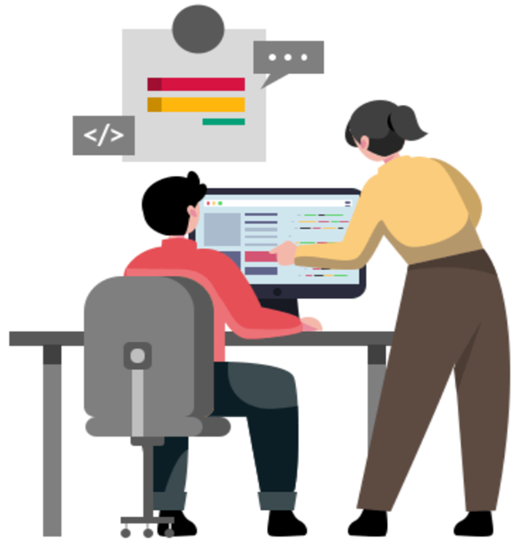
What is Back-End development?
Backend development forms the crucial, yet often unseen, backbone of websites and applications.
It handles everything "behind the scenes" from managing data and user interactions to ensuring security and performance.
Notes:
https://www.spec-india.com/blog/backend-technologies

Slide 5
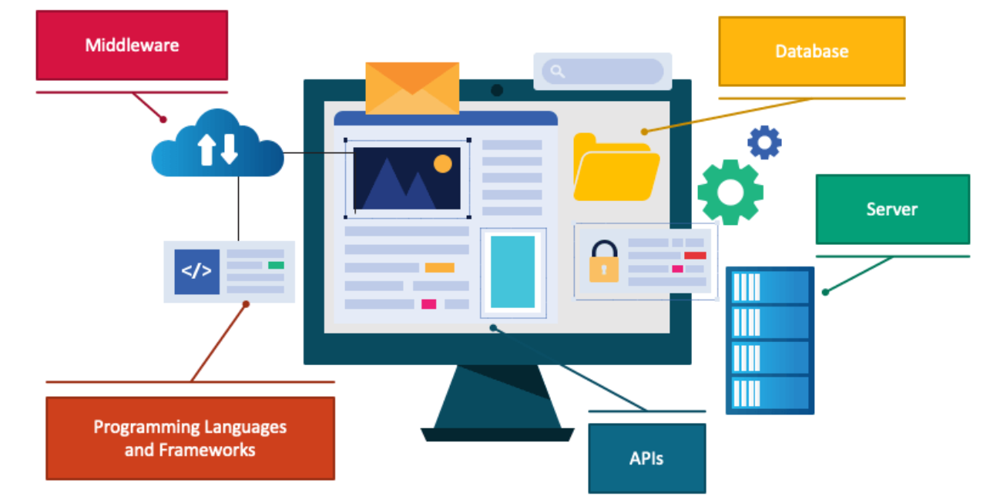
Tools & technologies for Back-End development

Slide 6
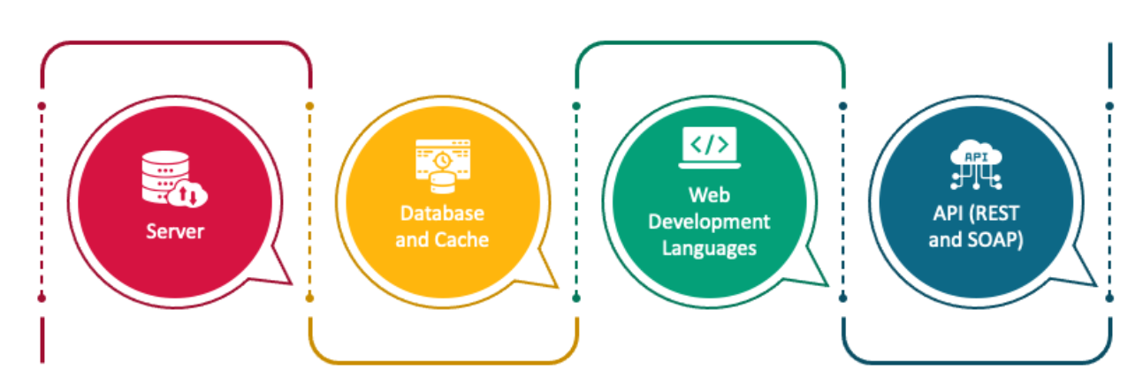
Back-End development skills

Slide 7


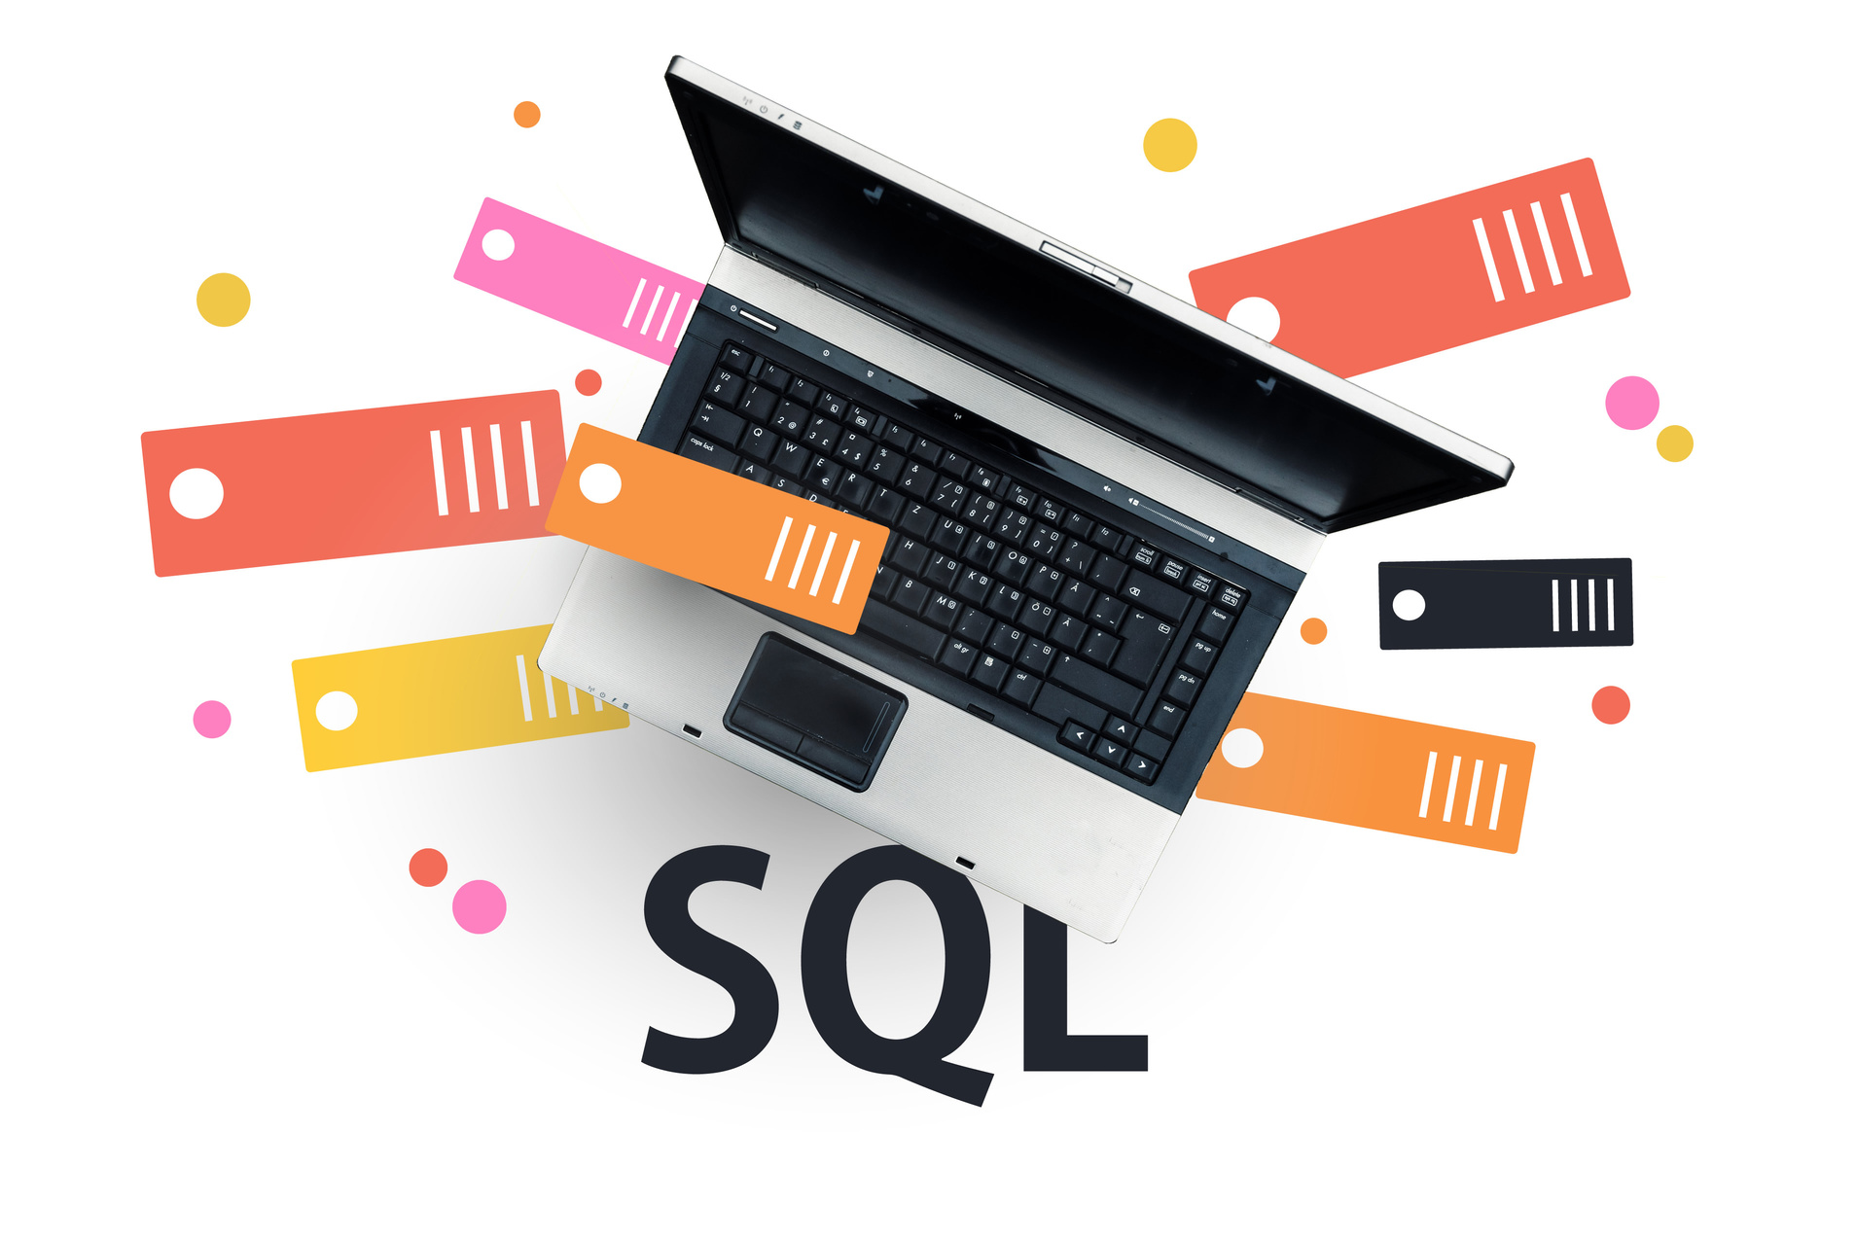
Back-End components
Programming Languages
Frameworks and Libraries
Databases
APIs (Application Programming Interfaces)
Microservices Architecture
Cloud Computing
DevOps Practices

Slide 8
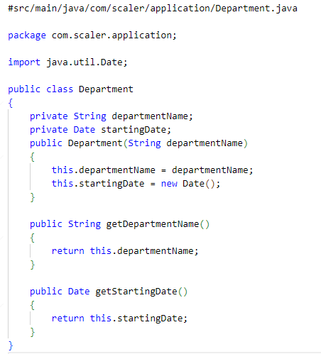
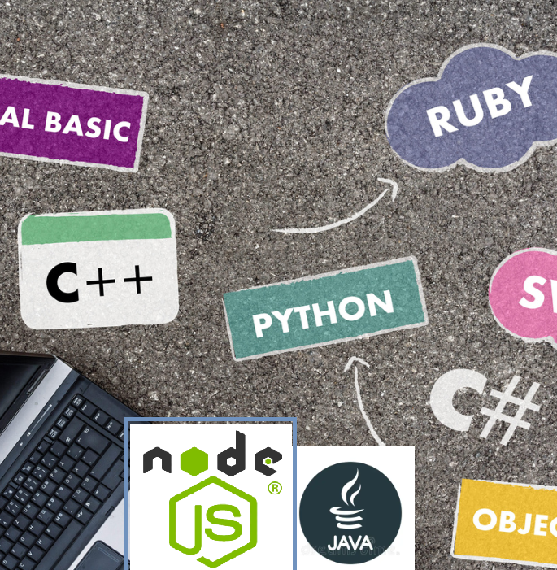
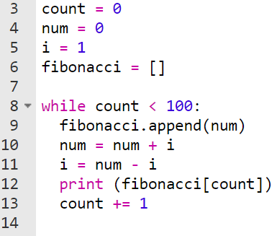
Back-End Programming languages
Python
Java
PHP
Ruby
Node.js
C#
…

Slide 9
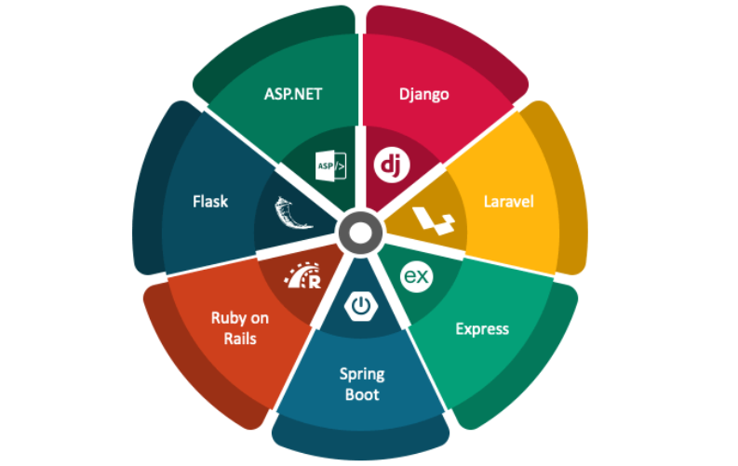
Popular frameworks for Back-End development
ASP.NET Core - a free, open-source web framework developed by Microsoft.
It's a server-side technology that provides dynamic website development, data access, and application services.
Django is a high-level Python web framework
Django API refers to building RESTful APIs using the Django framework.
Django's ORM (Object-Relational Mapping) layer connects to a database, allowing for efficient data storage and retrieval.
Flask - A popular open-source web framework written in Python.
It's ideal for building small to medium-sized web applications, web services, and web APIs.
Laravel, a powerful PHP framework, provides excellent support for building robust and efficient Web Application and RESTful APIs .
Ruby on Rails is a powerful web application framework written in Ruby
It emphasizes convention over configuration, making it easy to develop database-backed applications.
Express is a minimal and flexible Node.js web application framework that provides a robust set of features for web and mobile applications.
Spring Boot is a framework designed to simplify the process of building standalone, production-ready Spring applications.
It offers a range of features like auto-configuration and embedded servers, enabling developers to create microservices quickly and efficiently.
Notes:
https://www.interviewbit.com/blog/backend-technologies/

Slide 10
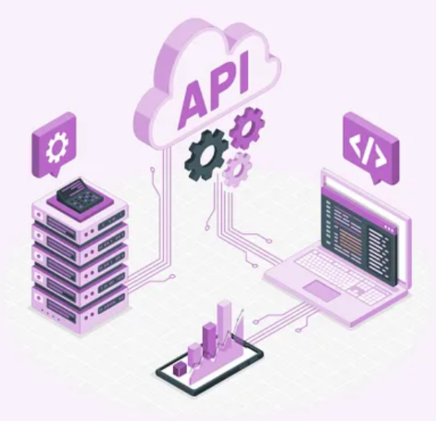
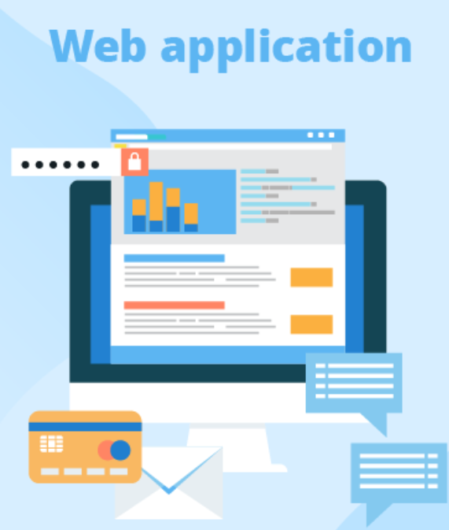
API vs Web application – The differences
Notes:
https://colorwhistle.com/api-vs-web-application/

Slide 11
API vs. Web Application – The differences
 | API | Web Application
Purpose | To provide programmatic access to data or services | To provide a graphical user interface (GUI) for users to interact with data or services
Accessibility | Typically accessed via code or command line interface | Typically accessed through a web browser
Data Format | Data is usually returned in a structured format (JSON, XML) | Data is displayed in a formatted manner on web pages
User Experience | Designed for developers and automation, may not have a user-friendly interface | Designed for end-users with a focus on user experience and design
Security | Can include built-in security features such as authentication and authorization | Can include security features but often relies on other layers (e.g. web server) for security
Scalability | Can easily handle a large number of requests and can be load balanced | Can be more complex to scale and may require additional infrastructure
Customization | Flexible and customizable, can be used to meet specific needs | Customization is depends on the design and architecture of the web application.
Notes:
https://colorwhistle.com/api-vs-web-application/

Slide 12
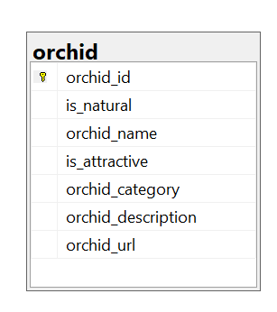
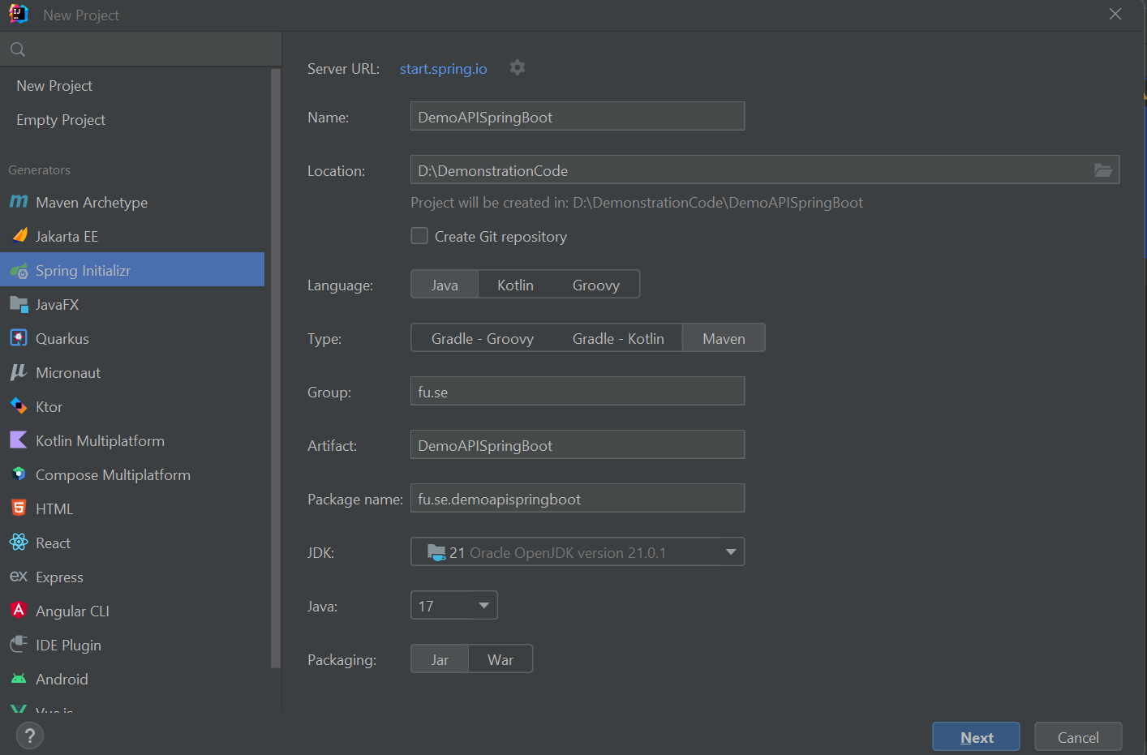
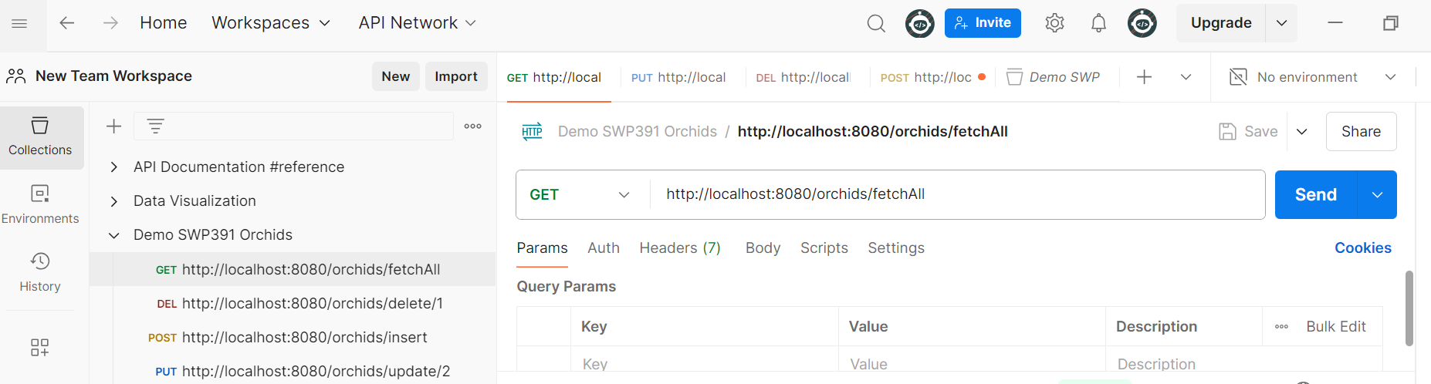
Demo - Building RESTful API with Spring Boot
Tools & Technologies
Spring Boot 3+
JDK 17+
Spring Framework 6+
Hibernate 6+
JPA
Maven 3.2+
IDE - IntelliJ/Eclipse/Spring Tool Suite
RDBMS - Microsoft SQL Server

Slide 13
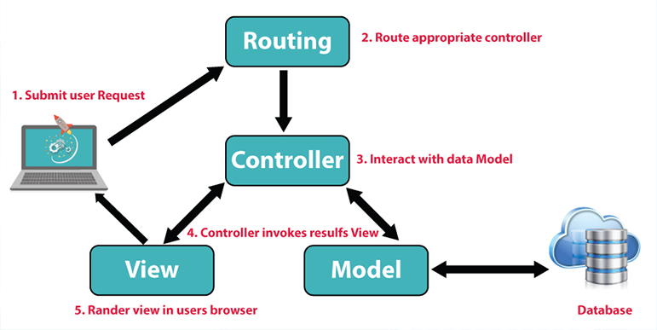
Demo - Building simple RESTful API with NodeJS
5. Render
https://fptcloud.com/mvc-la-gi/

Slide 14
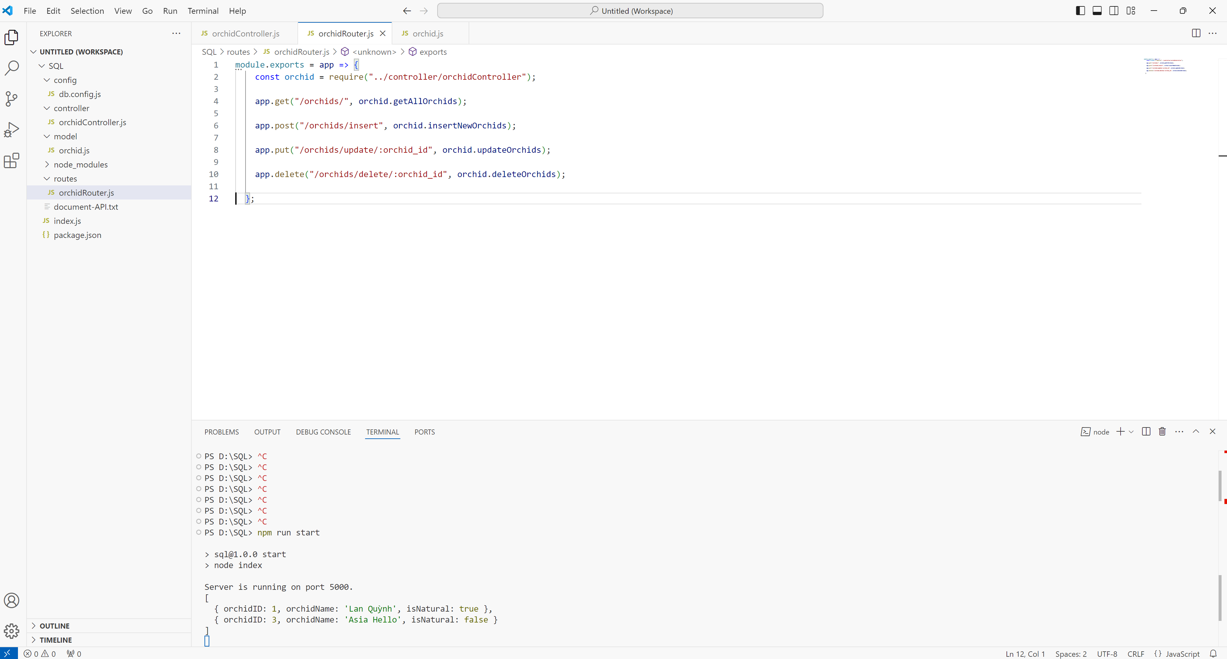
Demo - Building simple RESTful API with NodeJS

Slide 15
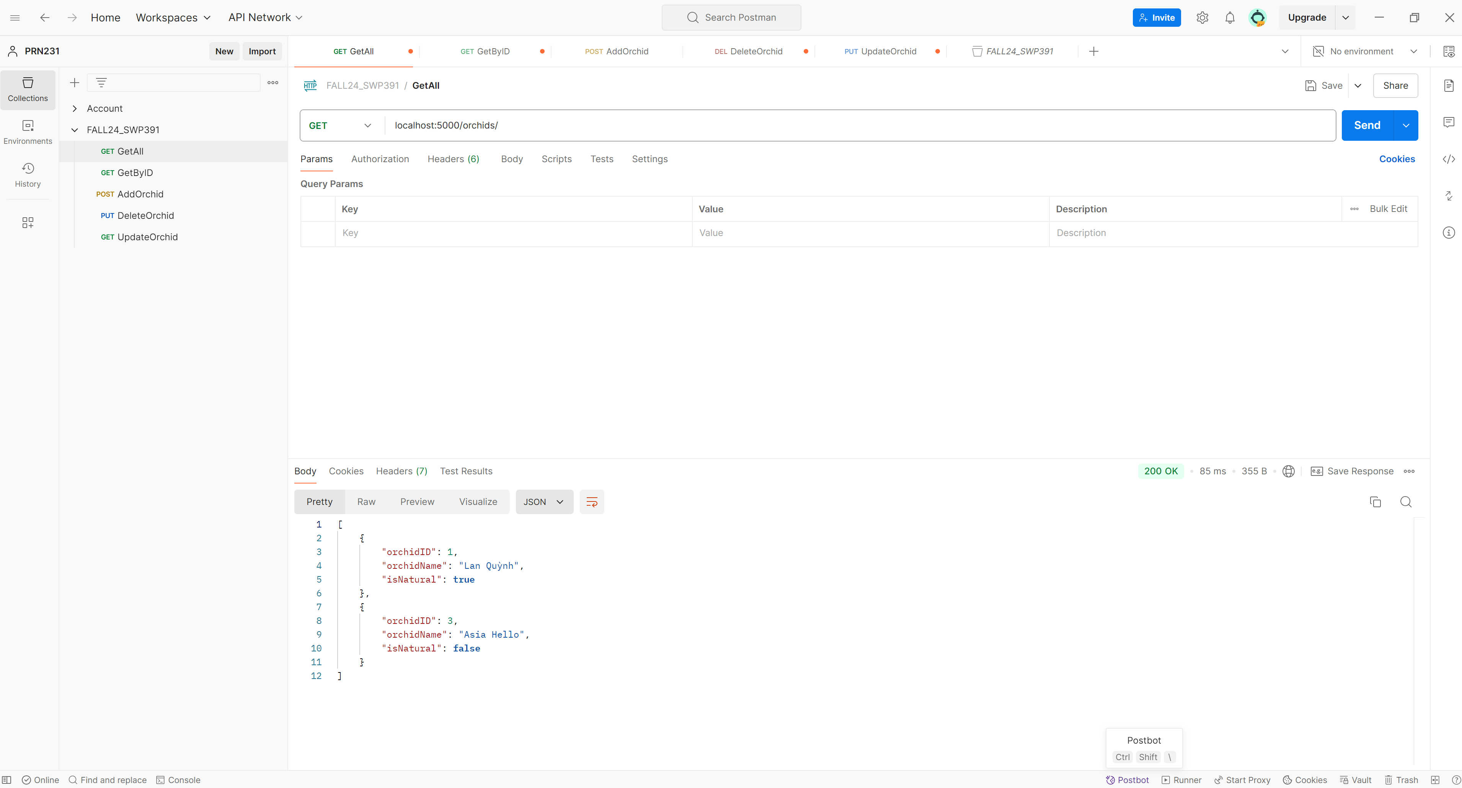
Demo - Building simple RESTful API with NodeJS

Slide 16
Thank you for your listening!
Q&A

Slide 17

Thank you for your listening!
Q&A

